Slide 1
DATA SCIENCE PROJECT

Slide 2
P496 Electric Motor Prediction

Slide 3
—GROUP 2 TEAM MEMBERS
Keerthi Mani Purna Chandrika
Neeraja B
Vaishnav P
Sajitha A
Aswanth TK
Sonam Akshay Sherkar
Jithin K S

Slide 4
CONTENTS
Introduction
Problem Statement
Dataset Details
Data Exploration & Missing Values
Histogram & Correlation Heatmap
Outlier Detection
Feature Relationship & Distribution Comparison
Scatterplot & KDE Plot
Findings & EDA Summary
Model Building
Deployment
Conclusion

Slide 5
INTRODUCTION
Electric motors are widely used in industrial and commercial applications, where accurate speed estimation is crucial for efficiency and performance. Traditional methods for predicting motor speed often rely on physical models, which can be complex and less adaptable to varying conditions. This project aims to develop a machine learning-based predictive model to estimate motor speed using available attributes such as voltage, current, torque, and temperature. By leveraging data-driven techniques, the model can enhance motor control, improve efficiency, and support predictive maintenance.

Slide 6
PROBLEM STATEMENT
Electric motors are essential in various industrial and commercial applications, where accurate speed control is crucial for efficiency and performance. However, predicting motor speed based on operational parameters such as voltage, current, torque, and temperature remains a challenge due to the nonlinear and dynamic nature of motor behavior. This project aims to develop a predictive model using machine learning techniques to estimate motor speed based on available attributes. By leveraging historical and real-time data, the model will enable better control strategies, improve efficiency, and aid in predictive maintenance, ultimately enhancing the reliability and performance of electric motor systems.

Slide 7
DATASET DETAILS
The dataset comprises several sensor data collected from a permanent magnet synchronous
motor (PMSM) deployed on a test bench. The PMSM represents a ccTest bench measurements
were collected by the LEA department at Paderborn University. This dataset is mildly
anonymized.
Comprehensive csv files containing all measurement sessions and features. Each row
represents one snapshot of sensor data at a certain time step. Sample rate is 2 Hz (One row per
0.5 seconds). Distinctive sessions are identified with “profile_id”.

Slide 8
FEATURE SET
ambient
Ambient temperature as measured by a thermal sensor located closely to the stator.
coolant
Coolant temperature. The motor is water cooled. Measurement is taken at the outflow.
u_d
Voltage d-component.
u_q
Voltage q-component.
motor_speed
Motor speed.
torque
Torque induced by current.

Slide 9
i_d
Current d-component.
i_q
Current q-component.
pm
Permanent Magnet surface temperature representing the rotor temperature. This was measured with an infrared thermography unit.
stator_yoke
Stator yoke temperature is measured with a thermal sensor.
stator_tooth
Stator tooth temperature is measured with a thermal sensor.
stator_winding
Stator winding temperature measured with a thermal sensor.
profile_id
Each measurement session has a unique ID. Make sure not to try to estimate from one session onto the other as they are strongly independent.

Slide 10
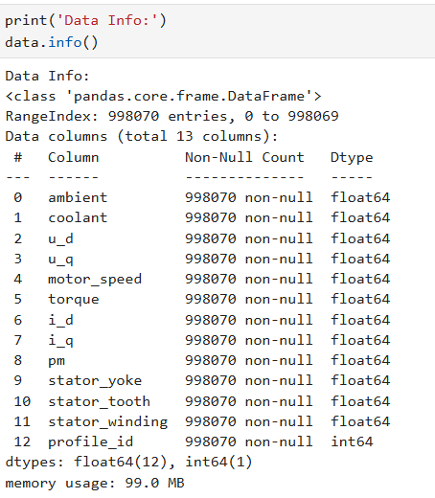
DATA EXPLORATION

Slide 11
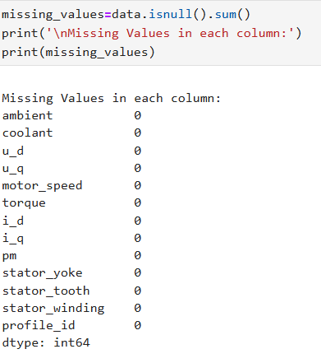
MISSING VALUES

Slide 12
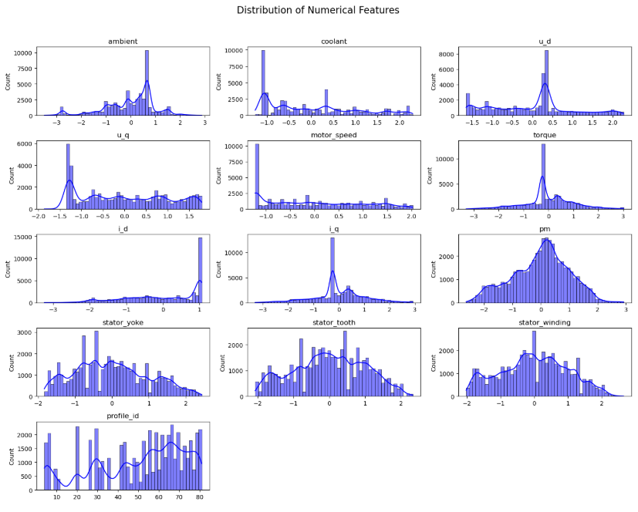
HISTOGRAM

Slide 13
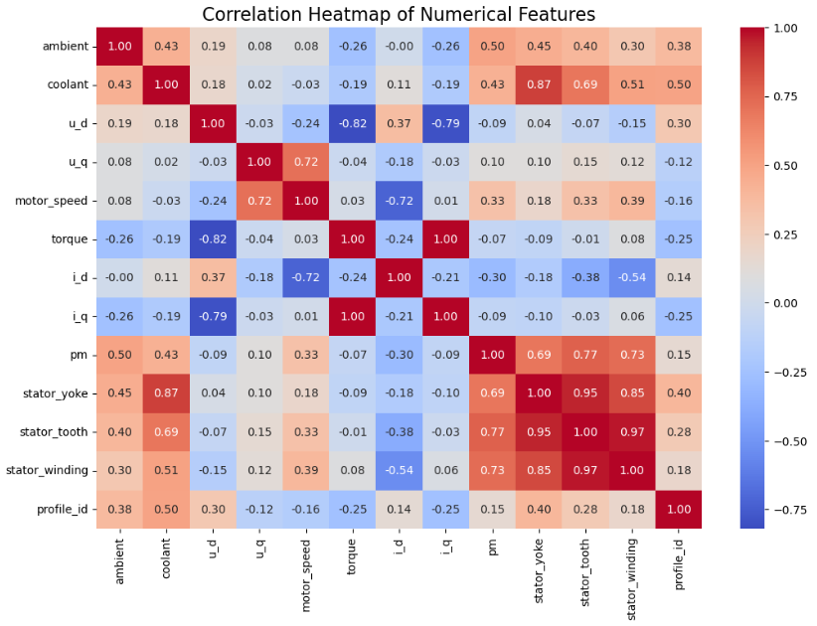
CORRELATION HEATMAP

Slide 14
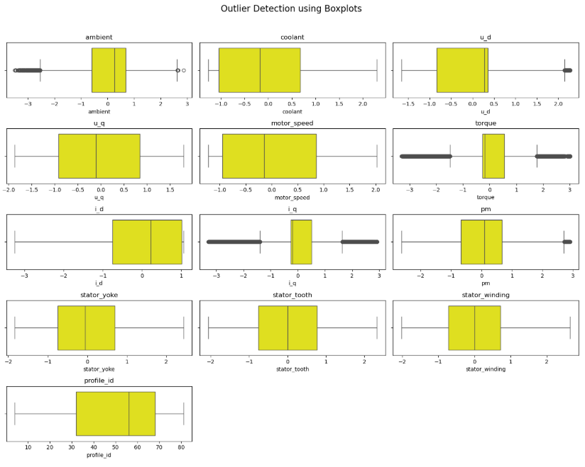
OUTLIER DETECTION

Slide 15
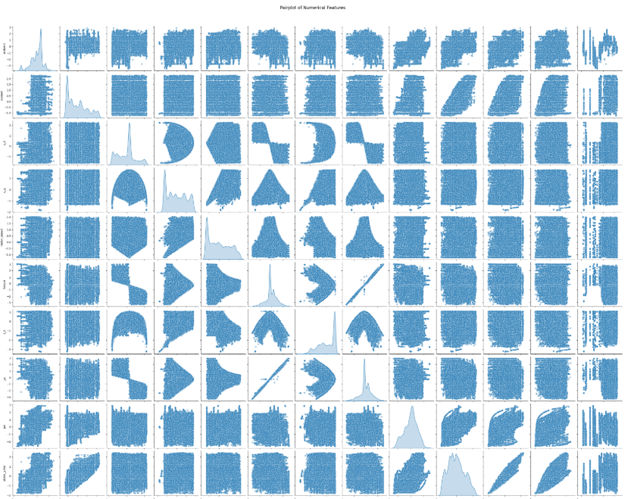
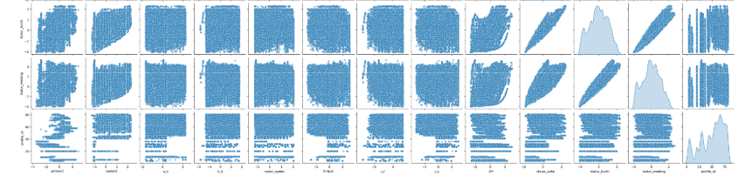
FEATURE RELATIONSHIP

Slide 16
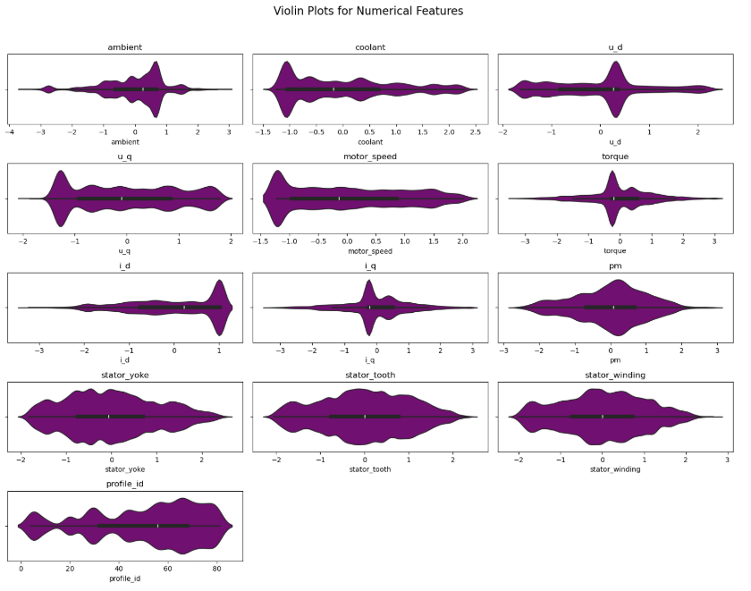
DISTRIBUTION COMPARISON

Slide 17
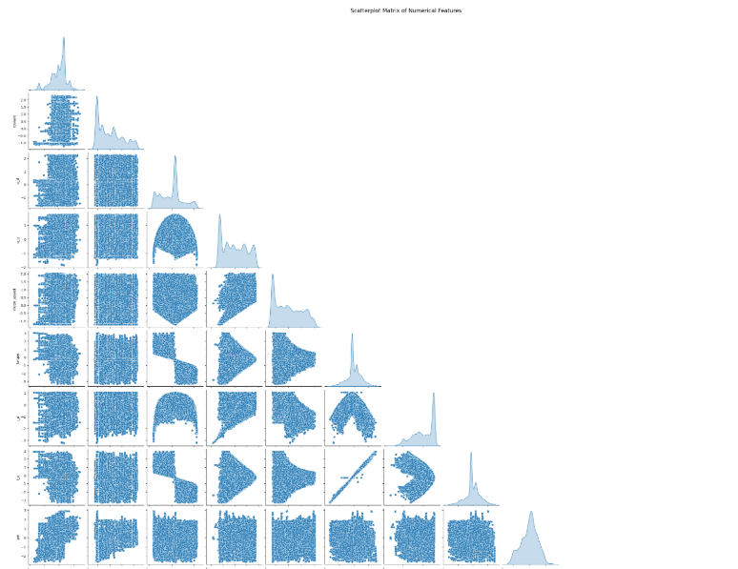
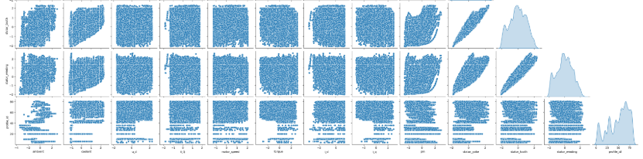
SCATTERPLOT

Slide 18
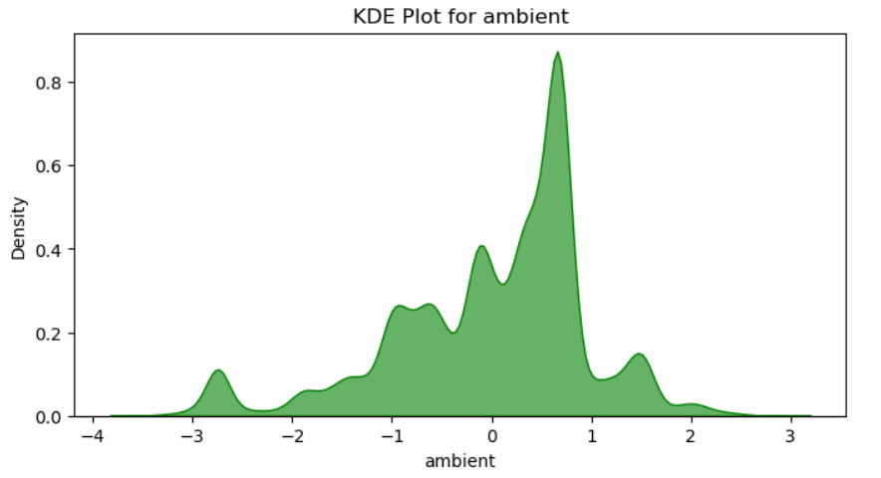
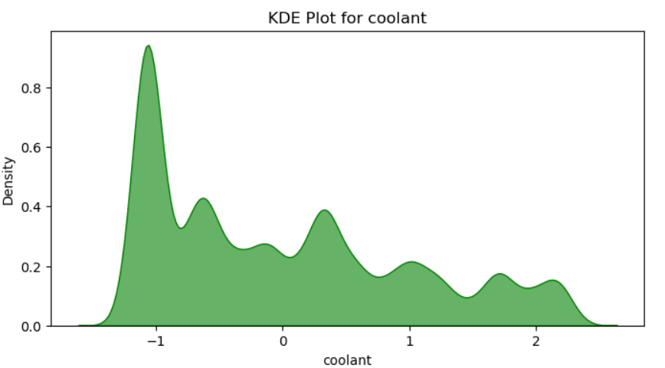
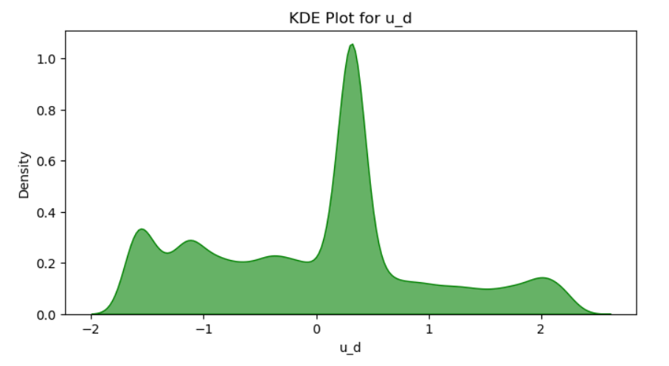
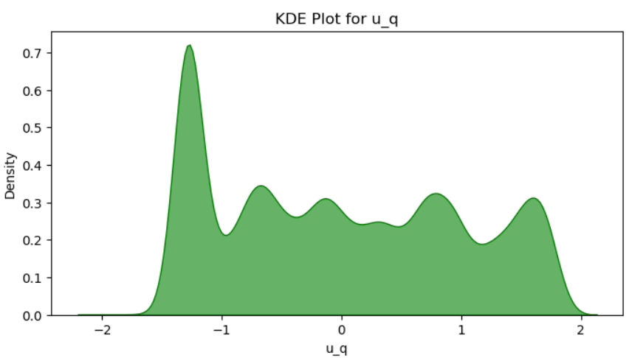
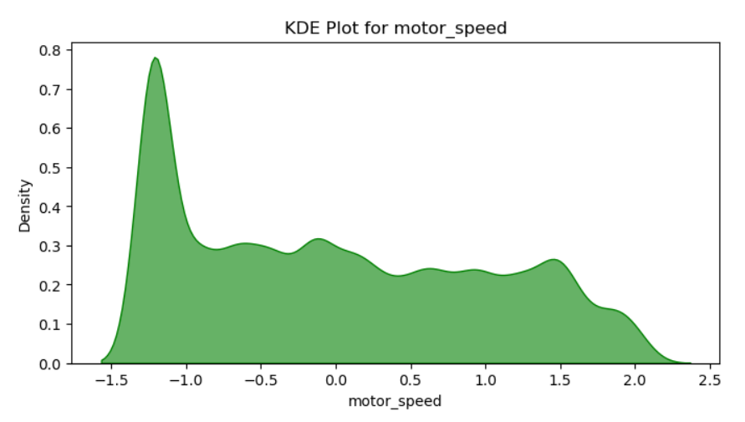
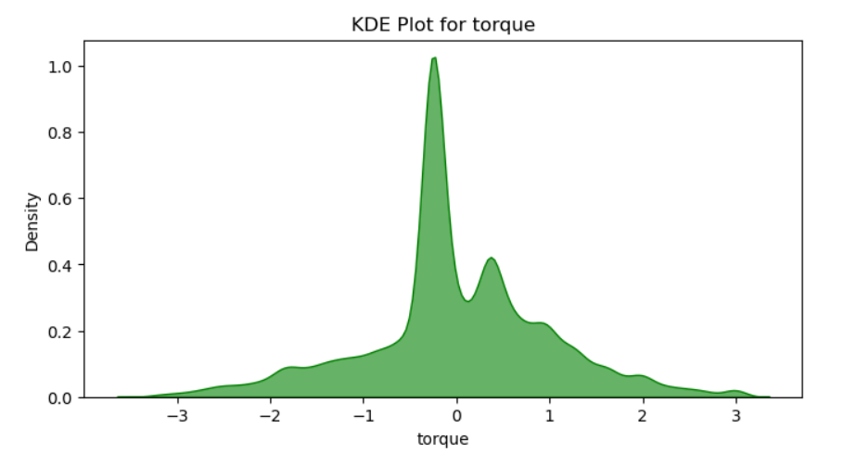
KDE PLOT

Slide 19
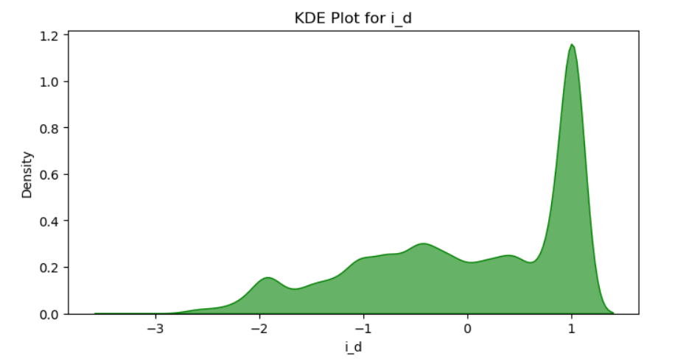
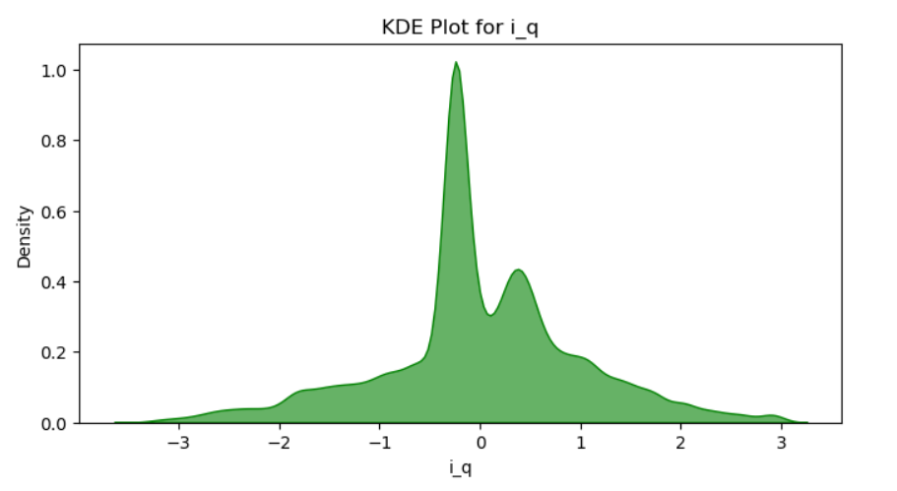
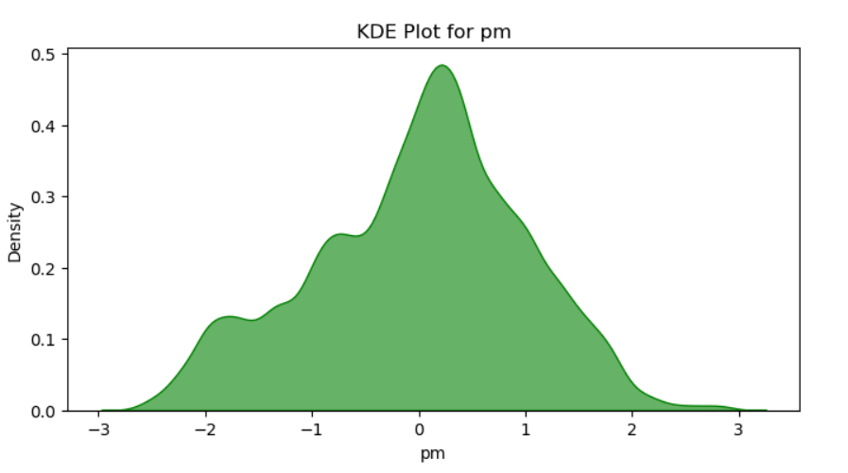
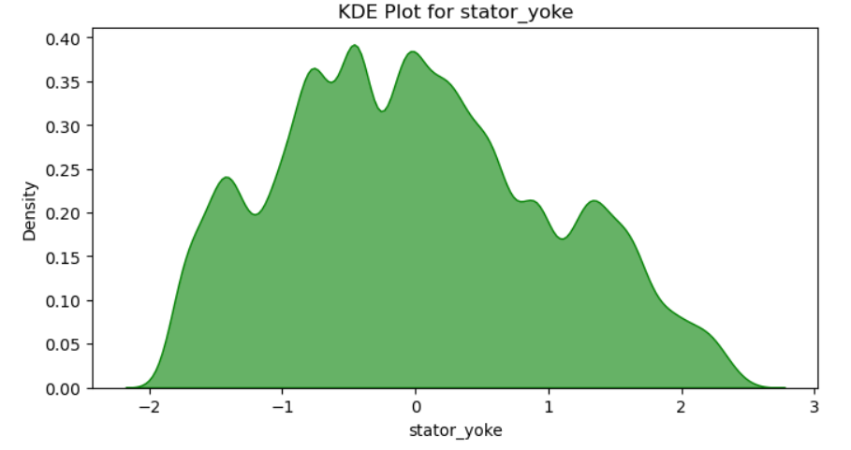
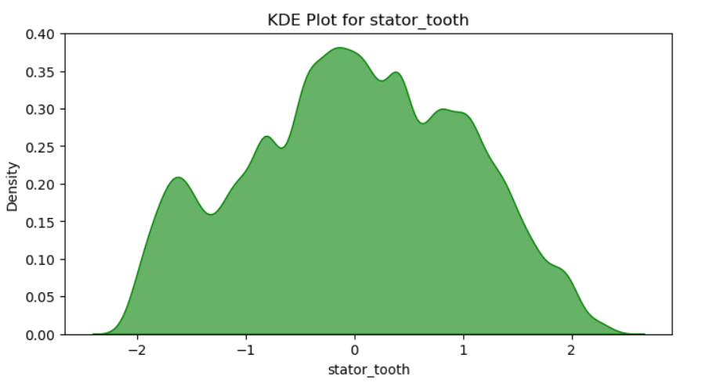
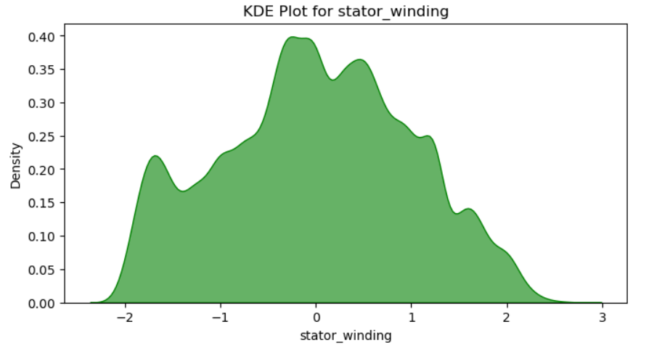
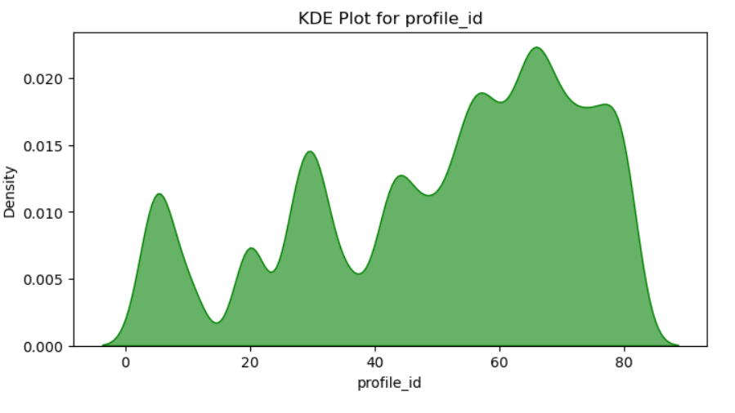

Slide 20
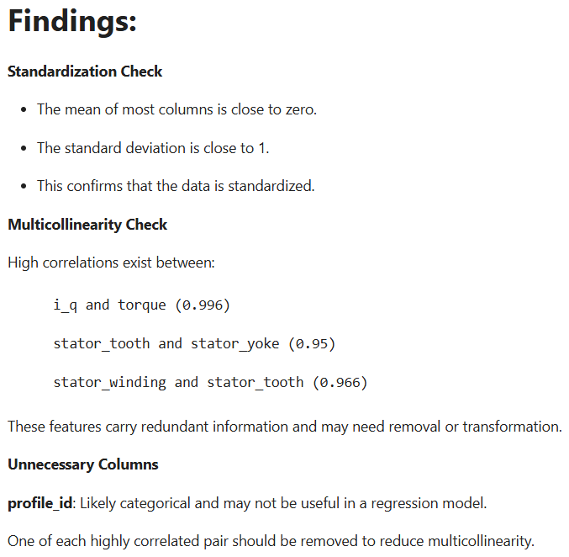
FINDINGS

Slide 21
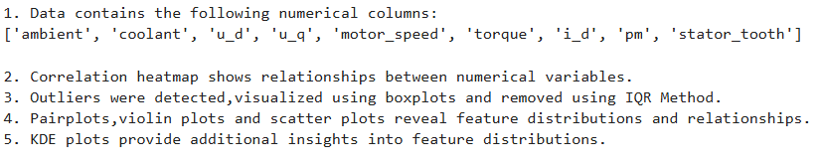
EDA SUMMARY

Slide 22
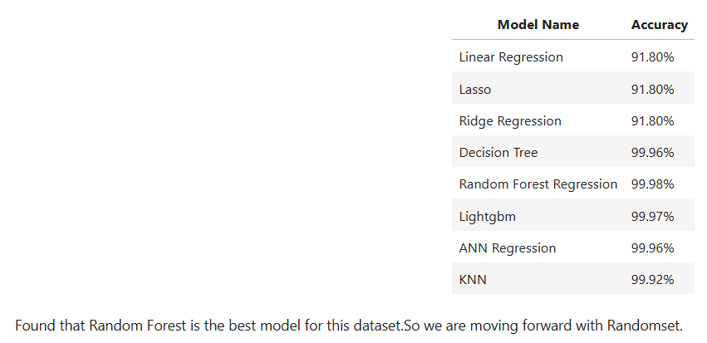
MODEL BUILDING
We used various machine learning models for predicting motor speed.The models used are,

Slide 23
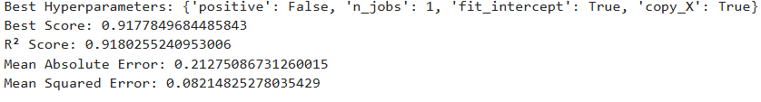
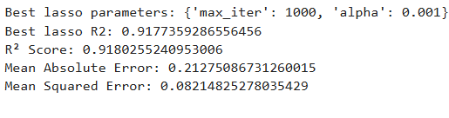
Linear Regression
Lasso Regression

Slide 24
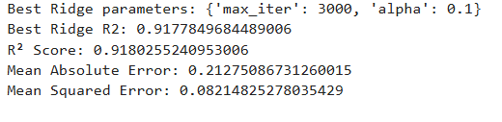
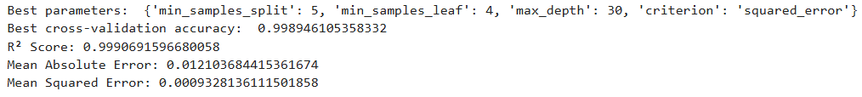
Ridge Regression
Decision Tree

Slide 25
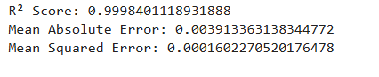
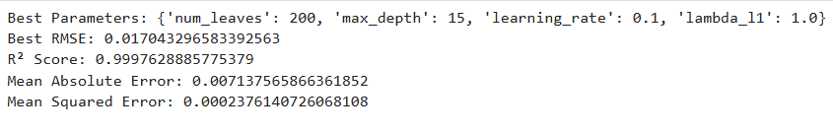
Random Forest Regression
Lightgbm Tree

Slide 26
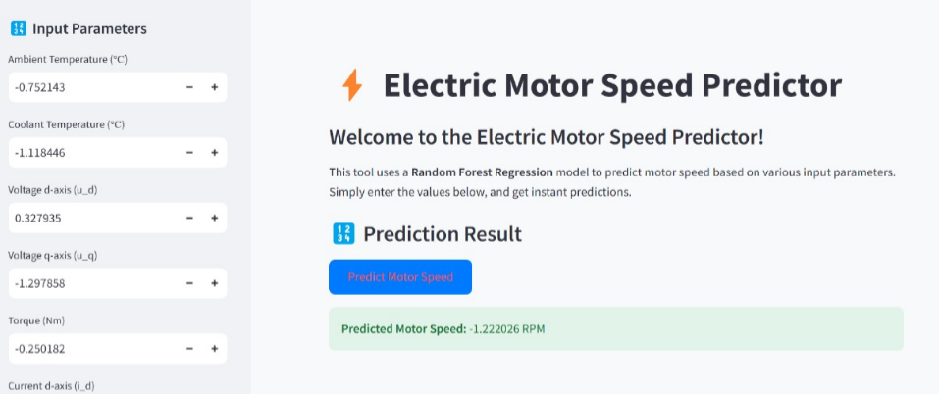
DEPLOYMENT

Slide 27
CONCLUSION
In conclusion, predicting motor speed using machine learning offers a data-driven approach to enhance efficiency, reliability, and control in electric motor systems. By leveraging key attributes, the model can provide accurate speed estimations, enabling better performance monitoring and predictive maintenance. This approach can lead to reduced downtime, optimized energy consumption, and improved overall operational efficiency.

Slide 28
Do you have any questions?

Slide 29
THANKS

